Slide 1
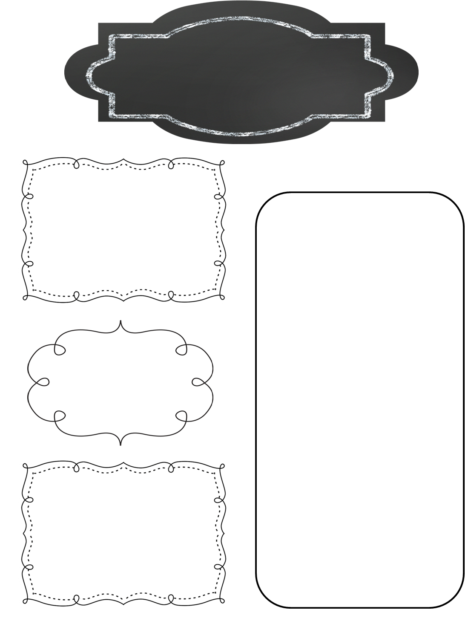
A Peek at This Week in…
Mrs. McFarland’s Class
Week of January 6th
Reminders
We are working on moving students towards greater responsibility. If work is turned in late, students will receive 50% of the grade they earned on the assignment. (Late meaning not fully completed at the time it was collected.) If the assignment is not turned in, students will receive a zero. I did A LOT of chasing down missing work 1st and 2nd quarter. I’m retiring my track shoes!
Hall of Presidents research has begun! Look for the red parent letter sent home Monday, January 6th!
Math (McFarland)
Middle of the year (MOY) review
Reading (McFarland)
Hound Dog True novel
Thank you to the parents & guardians that helped make our holiday party such a big success!
Spelling (McFarland)
No spelling during the novel!
Language Arts/Writing (McFarland)
Journal responses and writing prompts in response to novel
Upcoming Events
Friday, January 10th: Report cards available on line
Thursday, January 16th: Inter State will be here for yearbook casual photos
Monday, January 20th: MLK Day NO SCHOOL
Wednesday, January 22nd: Board meeting
Science/ Social Studies (Eldridge)
Science: N/A
Social Studies: Hall of Presidents research

